Slide 1
An Analysis of the East Side Coastal Resiliency Project
Urban Studio
Spring 2023
ESCR Project
By Janet Wang

Slide 2
Table of contents
01
02
03
04
Analysis Questions
Background on the ESCR Project
Timeline and Plans for the ESCR Project
Community Reaction and Concerns

Slide 3
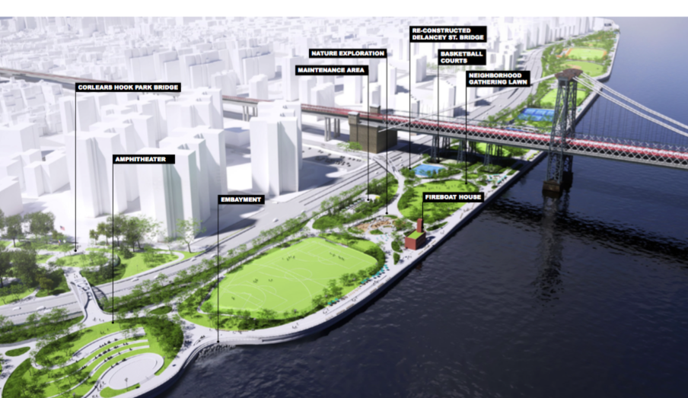
Location of ESCR Project
The East River Park is in the Lower East Side of Manhattan
Close to the FDR Drive and Williamsburg Bridge
The project stretches from Montgomery St. to East 23rd St.
Encompasses the neighborhoods of East Village, Stuyvesant Town, and Peter Cooper Village, which are under Community Board 3 and 6
2021
Notes:
The East River Park is located in the Lower East Side of Manhattan on the waterfront
It is adjacent to the FDR Drive and under the Williamsburg Bridge
The project will stretch from Montgomery Street to East 23rd St.
This encompasses the neighborhoods of the East Village, Stuy Town, and Peter Cooper Village
Which is also under Community Board 3 and Community Board 6

Slide 4
What are the goals of the ESCR Project?
Create an integrated flood protection system to mitigate coastal storm surge flooding and stormwater runoff concerns
Protect areas of the Lower East Side, East Village, Stuyvesant Town, and Peter Cooper Village
Improved access to the East River Park waterfront
Create a plan with resilience infrastructure with the input from communities
2021
Notes:
The design principles stated by the proposal was the priority of flood protection
They must take entire neighborhoods and districts into account.
The design should be community-driven.
The system should be able to be built
incrementally.
The requirements of different sectors such as (housing/transit/energy/urban development) should be addressed by one solution.
Flood protection should be tied to community benefits through (better open space, better
access to housing, jobs and education, lower insurance rates, allowing government
investment to be leveraged with local and sectoral funding in a Resilient Community District.
So from their perspective mixing the philosophies of Robert Moses and Jane Jacobs for their project plan.

Slide 5
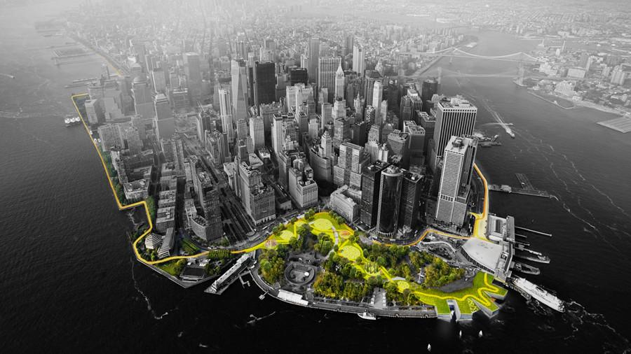
History of the ESCR Project?
$1.45 billion infrastructure project in New York City and part of the larger Big U project
$1.112 billion from city capital
$338 million HUD-CDBG
Following the disaster of Hurricane Sandy the issue of flooding and sea level rise was prioritized
- The Big U concept was conceived through the Rebuild By Design competition created by U.S. Department of Housing and Urban Development (HUD)
2021
Notes:
The project was conceived through a federal urban design competition called Rebuild By Design.
The Rebuild By Design Competition was created by HUD (US Depratment of Housing and Urban Development) Where they partnered with nonprofits and the philanthropic sector to to create innovative urban design project to address the impact of Hurricane Sandy’s and future disasters in the eastern U.S.
Federal funds for this competition was created in 2014 by President Obama when he launched the National Disaster Resilience Competition, which awarded $1 billion to 13 cities and states across the country to fund resilience-building projects.
The ESCR project is a section of the Big U concept which was conceived Bjarke and Ingels Group architecture firm. The Big U idea encompasses all of lower manhattan and coastal project that stretch to the Lower West Side as well.
The ESCR project is the largest coastal resiliency project in the city and will cost $1.45 billion
The project is mostly supplemented by city capital with $1.12 billion coming from the city, but is also supported by federal funds, specifically from the HUD-Community Development Block Grant Program.

Slide 6
Timeline of the Project
2015
2017
2019
2021-2026
Bidding for the project and community outreach began, project given to IPC Resiliency Partners
Community proposed plan was finalized with a projected cost of $750 million
Final design vote took place, where the budget went up and plans were changed
Notice to proceed construction began on August 2021 and aim to be completed in 2026
Notes:
After Hurricane Sandy 2012, New York City and the federal government wanted to prioritize the issue of flooding and climate change in a coastal area
The beginning of this project started in 2015 where the bidding for the project began and was given to IPC Resiliency Partners to construct.
This then began the process of community outreach and input for the project began, the community and city agencies finalized a plan in 2017, and was informed that the project was estimated to cost $750 million
However in 2019, there was a final design vote where the plans for the park was changed and the community was not informed.The plans involved burying the East River Park, building a new 8-foot flood wall and placing a new park on top of that wall. The city admitted to the failure of not informing the community about the changes but decided to proceed with the plan. The projected cost of the project also increased to $1.45 billion. This is the time where the park sparked controversies and backlash from the community about lack of transparency was beginning to protest the park construction, opposition largely coming from East River Park Action.
In August 2021, the notice to proceed construction began and now the park is currently undergoing construction and the park is aimed to be completed in 2026.

Slide 7
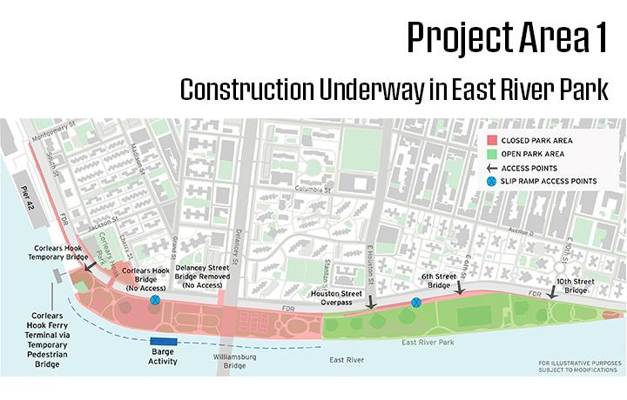
Current Plan
Notes:
This is the first project area they are focusing on that stretches from Montgomery St. to E15th St. This includes areas under the Williamsburg Bridge and sits right next to the FDR Drive. The red areas signify the areas with no access and the green would be the still accessible park space for residents. Currently, there is only about 42% of the park that is still accessible.

Slide 8
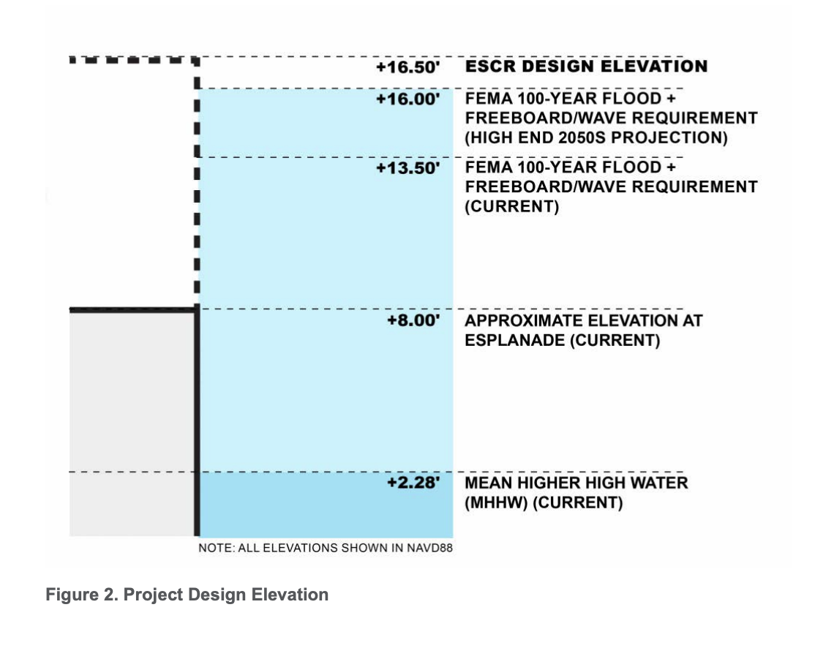
Current Project Design
Notes:
This was a project design diagram found in the New York City Department of Design and
Construction East Side Coastal Resiliency Updated Benefit-Cost Analysis Report.
As you can see they use projections of the high end of 2050 and describes the elevations that the ESCR project would be built
There is still a use of flood gates and water seepage barriers but majority of the park will be using an elevated design

Slide 9
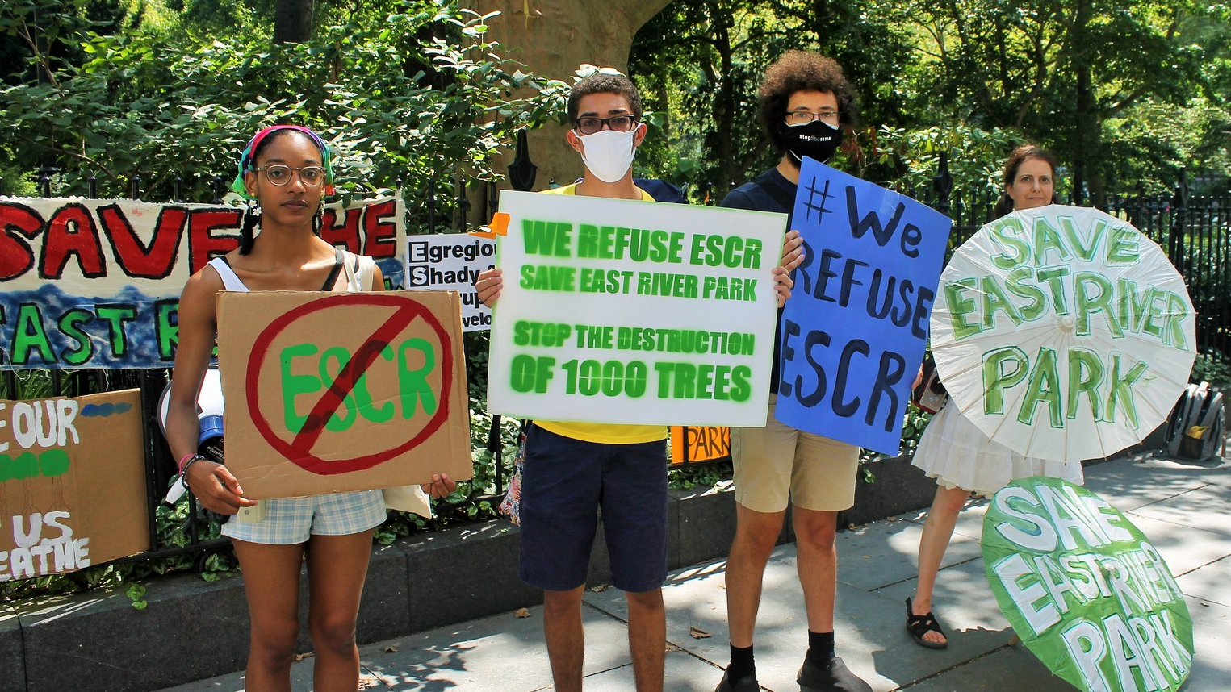
Community Reaction
Backlash and protests on how the construction project has been executed from organizations such as the East River Park Action and the 1000people1000trees Collective
Notes:
The building of the park has faced backlash and protests from people in the community and people who regularly use this park as their green space. The organization that have been on the forefront of the protests is East River Park Action as well as other offshoot groups such as 1000people1000trees collective that focus more exclusively on the trees that are being cut down for the construction of this park.
To get the information of how the community feels I did mostly focus on the opposition side, so there is a bias here. I exclusively talked with Nina Watkins and Tommy Loeb. Nina Watkins is a long time resident of the LES and Tommy Loeb is a key organizer at the East River Park Action.

Slide 10
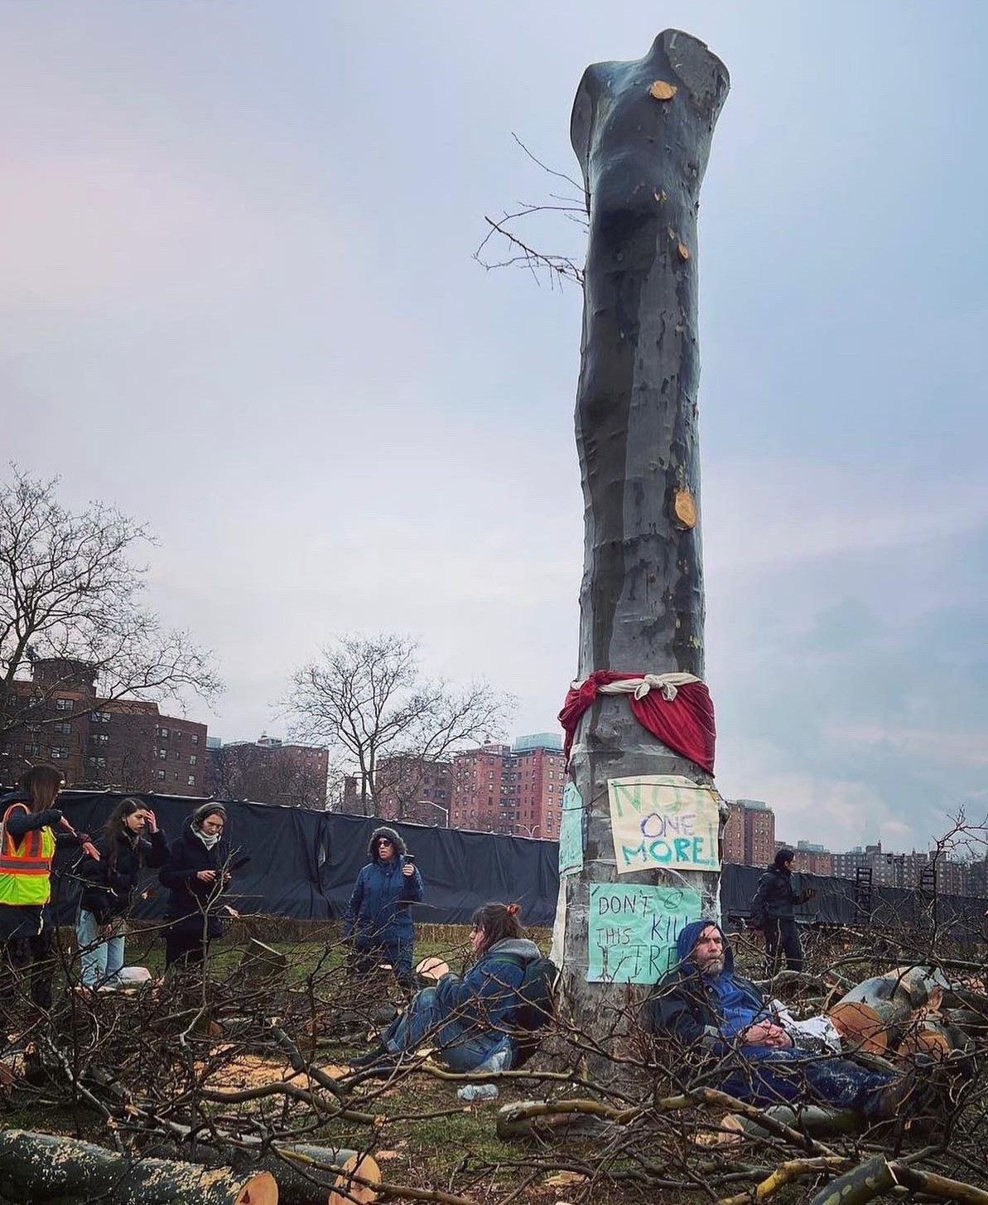
Community Concerns
The community wanted a more comprehensive and innovative resiliency project
There is a distrust in the city agencies after they scraped the community plan in 2019
Fears that this project promotes economic development and real estate development over the health of the community or the environment
Notes:
The community disliked that this new proposal was being fast-tracked and there was a lack of clarity on its environmental impacts and the fact that the nearby communities won’t have access to recreational space while the park is being constructed.

Slide 11
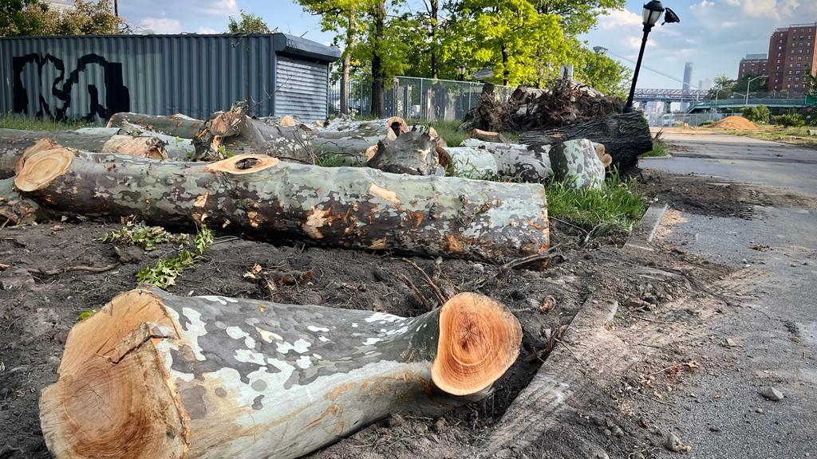
Critiques of the Project
The project created ecological disasters and posed dangers to the environment and surrounding communities
70% of park is demolished, only 30% is open
Cutting down of hundreds of mature trees
Pier 42 is an ongoing project
Only protects against storm surge and sea level rise by raising the park 8 feet and flash flooding only
Project designed to be redone in next 30 years
2021
Notes:
Ecological perspective:
Many mature trees were being cut down for the park and the ecological system was being disrupted in a much larger scale than expected.
Vague environmental assessment and there is still public health concerns related to construction and air quality
Community Planning perspective:
limited access for sports areas and designated recreation areas due to the closures.
promised amenities not delivered yet, ongoing project such as Pier 42 which was promised to be open space but it is still under construction.
limited input and budget constraints caused executive decisions.
In 2019 the community plan that was a innovative plan that uses different means for climate protection such as sea barriers, water retention areas and new flood pumps was scraped and the NYC DDC pivoted to the new plan that is being created now. The downsides is that this plan is not as comprehensive and innovative and relies on raising the park up. This project also costs more than the community plan which was estimated to cost $750 million but the current plan is now $1.45 billion.
Design perspective:
Park design only planned for rain surges 1.75 inches of rain per hour, which may be able to handle the rates for Sandy, but for example comparing it to Hurricane Ida the rate of rain came down at 3 inches per hour. (comparing the incidents of Hurricane Sandy vs. Ida)
Park was designed to be able to to add more height in the future and does not guarantee for flood projections after 205
As shown previous in the guidelines, projects are fit into decadal projections and for specific time spans and not designed pas that specific time projections

Slide 12
How the city defines climate resiliency?
What is the role of community participation?
What are future resiliency plans?
Notes:
The three questions i would like to further highlight is how does the city define climate resilience and what are their goals? What is the role of the community when it comes to planning? And what are future resilience plans for the city?

Slide 13
Defining Climate Resiliency
Notes:
According to the Climate Resiliency Design Guidelines created by Mayor's Office of Resiliency (MOR) this diagram shows what goes into the cities climate resilience projects. There is the input of historic weather data, NPCC (New York City Panel on Climate Change) climate change projections, Climate resiliency design guidelines and building code/design standards
Major areas of concern listed in the report are: urban heat island effect, increasing precipitation and sea level rise.
Goals of climate resilience plans are to protect the City’s public investments into the future, incorporate forward-looking climate change data in the design of capital projects, and create codes and standards that regulate the design of facilities
The city believes that resilient design choices should be made as an integral part of the City’s project planning, risk management, and financial planning.
Capital projects and resilient design choices should be selected to maximize the efficiency of investments

Slide 14
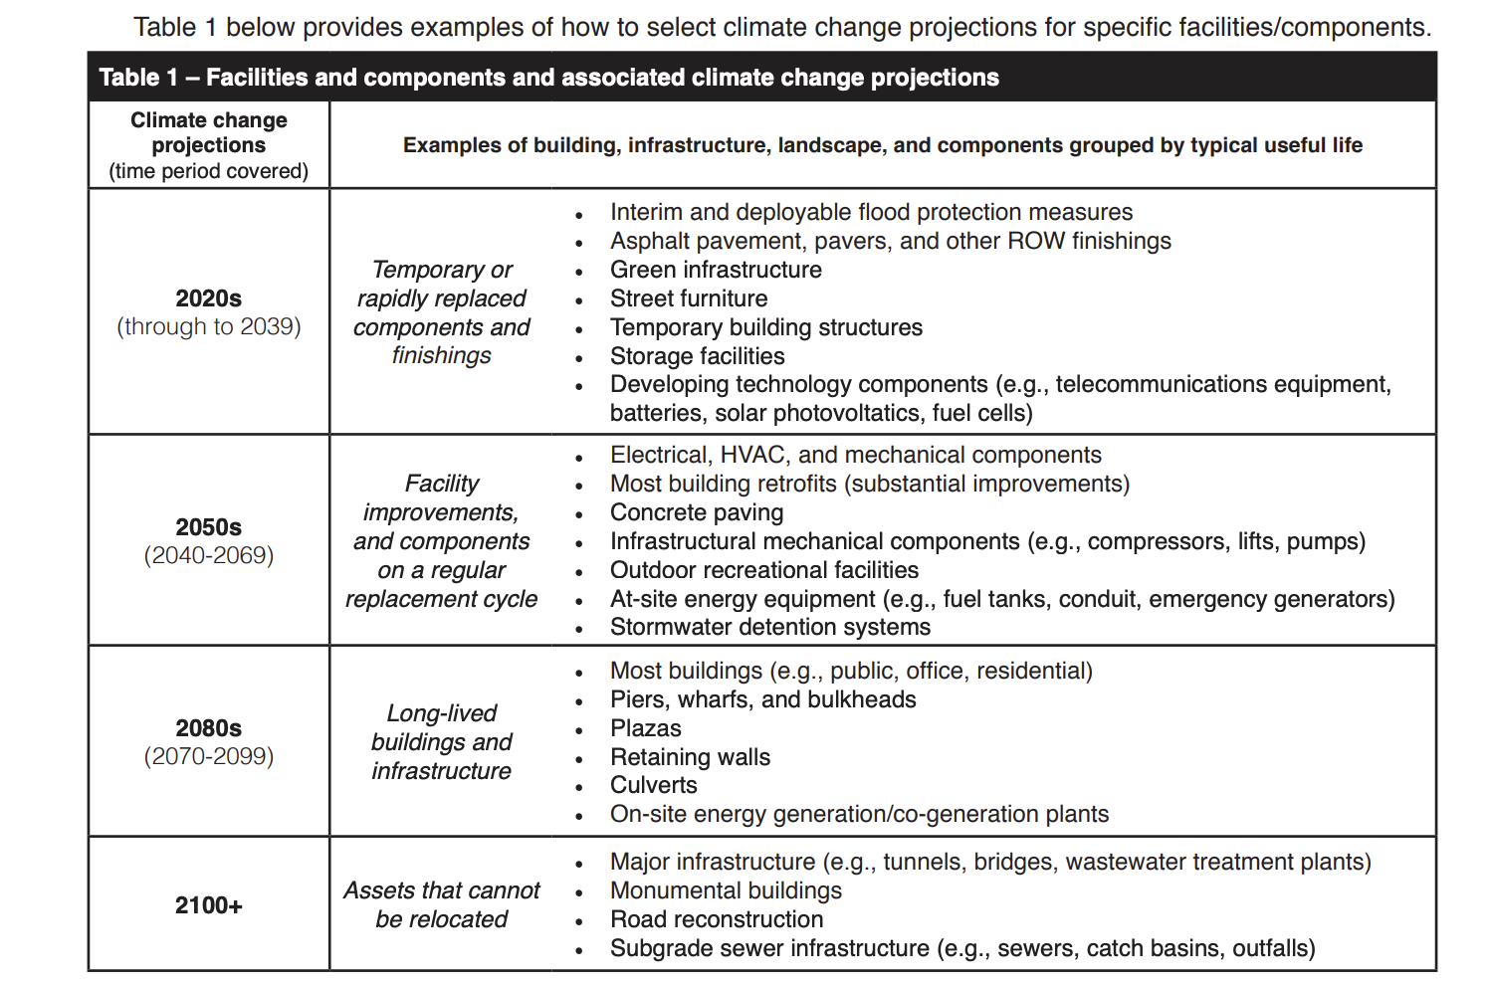
Defining Climate Resiliency
Notes:
Another important diagram in the report is this table that shows Climate change projections for NYC, as defined by the NPCC(New York City Panel on Climate Change) , are broken into decadal projections.
So in the case of the ESCR Project it would fall under the second section for 2050s projections and this includes facility improvements,such as outdoor recreational facilities, stormwater detention systems, building retrofits
The main takeaway from this table would be that not all projects are designed to be climate resistant for the long term future and that why will generally be designed to withstand a specific decadal time projection.

Slide 15
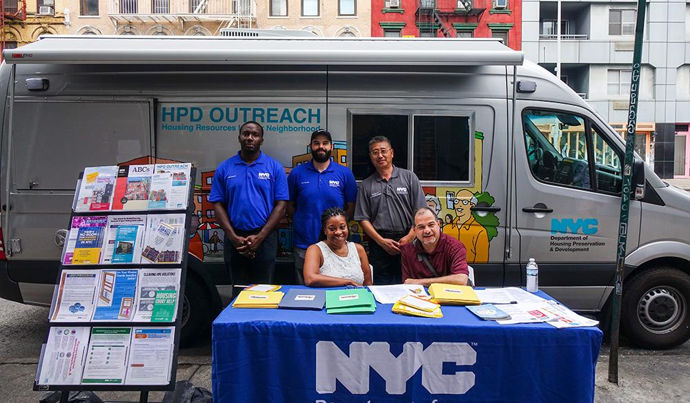
The Future of Participatory Planning
Creating outlets and pathways for community input creates a more democratic planning process
Understanding the importance of including community input in city planning projects
Prioritizing community participation can create more just and inclusive policy
Prioritizing financial efficiency and protection of physical facilities overlooks the importance of how these projects impacts surrounding communities
2021
Notes:
The NYC Design Guidelines lacks the inclusion of community participation and the effects and impacts climate resiliency projects can have on surrounding communities and how to support their development side by side with combating climate change in the city
Large emphasis on effective financial planning and financial security over time as the risk increase due to climate change
Rules for projects go between time projection frames and not all projects are designed to be resilient past that time projection
Participatory planning will only strengthen when there is consistent communication and trust between the city and its communities, there is no point in trying to create community outreach if at the end of the day, their plans get scraped and the city prioritizes their own goals and fast tracks their own project idea
Prioritizing financial efficiency and protection of physical facilities overlooks the importance of how these projects impacts surrounding communities

Slide 16
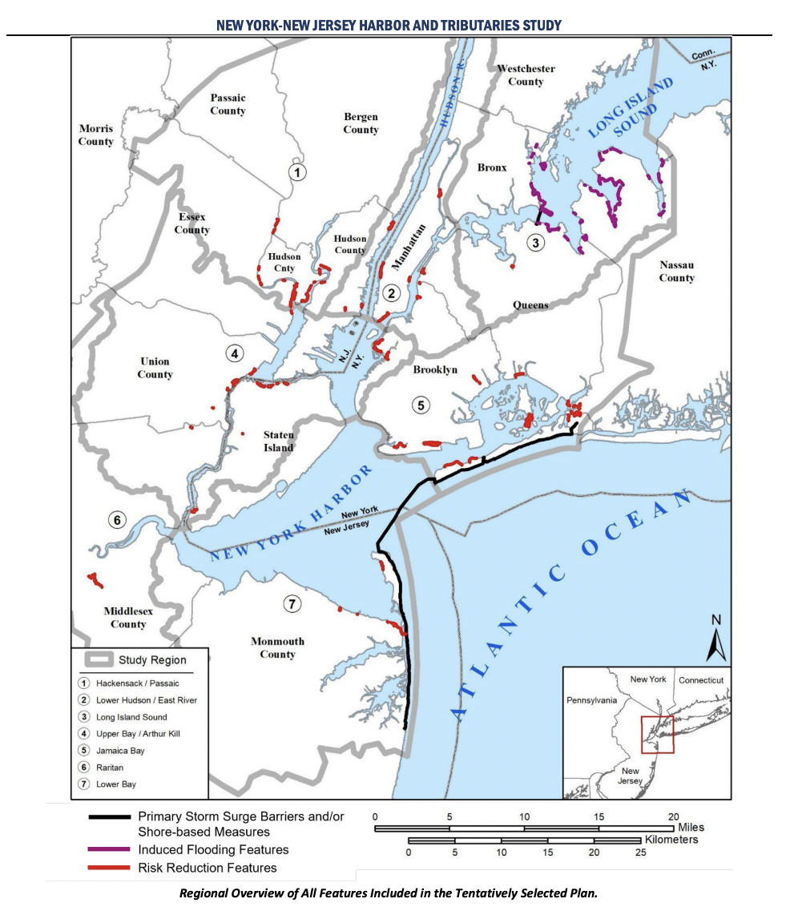
Future of Climate Resiliency Projects
The case study of ESCR Project sets an example of the process for climate resiliency projects
Important to research and understand the nuances proposed projects not all green infrastructure are always “good”
Other areas of the New York City and the New Jersey Region are seeing similar coastal resiliency plans
Notes:
As climate change becomes more of a priority for coastal cities, more project like this would need to be created to protect the cities community from storm surges and rising sea level concerns. It is important to understand that project proposals can be nuanced and that often I think the city conflates any green infrastructure project as being environmentally conscious but does not always address the concerns of long term protection and environmental justice. Other areas of New York and the New Jersey Region are seeing similar coastal resiliency plans in a proposal created by the US Army Corps of Engineers where they are looking to expand similar projects to the other boroughs of NYC using similar techniques of flood walls and elevated shorelines. However all the plans and locations are tentatively chosen right now. Even though many of these plans are preliminary there is already rising concerns from shoreline communities and how it can be ecologically damaging and there will be disruption to the access of greenspace.

Slide 17
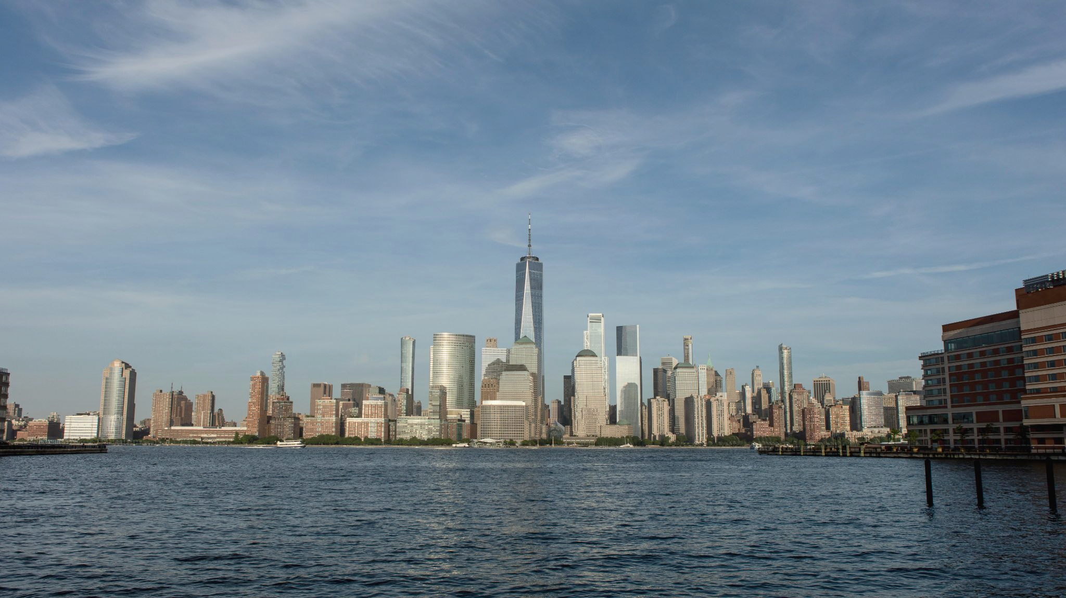
Conclusion
The ESCR project in New York City is one of the largest coastal resiliency projects in the US, but it has shortcomings that can be analyzed to improve future planning. Community participation is crucial for creating inclusive policy that protects current and future communities, and climate goals should prioritize the protection of New Yorkers over economic benefits.
Notes:
To conclude the ESCR is a look into how one of the largest coastal resiliency project in the US is planned and executed. Looking at this project specifically we can understand and analyze the shortcomings of this plan to improve planning for the future. Especially when climate change and climate funds are being prioritized, right now is a great opportunity for us to create good climate policy that addresses environmental concerns and protection but also still allows for access to our urban spaces. New York City’s climate goals should be redefined to include more of an emphasis on protection of New Yorkers rather than the focus of the economic benefits behind coastal resiliency project. The use and importance of community participation is a pathway to create more inclusive policy and creates a solution that protect the current community and protect their future.

Slide 18
References
NYC Mayor's Office of Resiliency. (2019). New York City Climate Resiliency Design Guidelines. Retrieved from https://www1.nyc.gov/assets/orr/pdf/NYC_Climate_Resiliency_Design_Guidelines_v4-0.pdf
Kimmelman, M. (2021, December 2). What Does It Mean to Save a Neighborhood? Retrieved April 19, 2023, from https://www.nytimes.com/2021/12/02/us/hurricane-sandy-lower-manhattan-nyc.html
Kensinger, N. (2019, October 17). Inside the controversial plan to remake the East River waterfront. Curbed NY. Retrieved April 19, 2023, from https://ny.curbed.com/2019/10/17/20918494/nyc-climate-change-east-side-coastal-resiliency-photos
New York City Office of Management and Budget. (2019). East Side Coastal Resiliency Project Benefit-Cost Analysis Report. Retrieved from https://www1.nyc.gov/assets/cdbgdr/documents/amendments/ESCR_BCA_Report_Final.pdf
City of New York. (n.d.). AdaptNYC. Retrieved from https://climate.cityofnewyork.us/initiatives/adaptnyc/

